Slide 1
What Good coaches do
“When coaches and teachers interact equally as partners, good things happen.” Jim Knight

Slide 2
Seven partnership principles
The way we interact with others makes or breaks most coaching relationships.

Slide 3
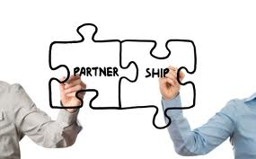
equality
In true partnerships, one partner does not tell the other what to do; both partners share ideas and make decisions as equals.
Coaches and teachers alike must feel equal.
Coaches must communicate respect for the teachers with whom they collaborate in order to avoid resistance.
Don’t project the idea that coach knows more than the teacher.
Must take time to build a relationship.

Slide 4
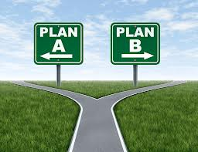
choice
Partners don’t choose for each other. Coaches must position teachers to be the final decision makers.
When you insist, they will resist.
“If I can’t say no, then saying yes has no meaning.”
However, choice does not mean teachers may choose not to be professionals.
ALL must be engaged in professional growth.
Administrative leadership
Most want a say in what and how they learn.

Slide 5
voice
Conversations should be open and candid, as though with a trusted friend.
Professional learning should be driven by the teachers’ goals for themselves and their students.
Teacher’s motivation comes from seeing how professional learning matters to them or their students.

Slide 6
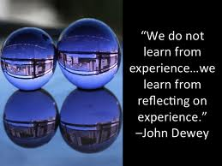
reflection
Much of the pleasure of professional growth comes from reflection.
A coach should serve as a thinking partner or sounding board for teachers, and coaching should be a meeting of the minds.
Strong coaching often means both parties are involved, enthusiastic and energized.

Slide 7
dialogue
Goal is for the best idea to win, not my idea.
Should be a two-way conversation where both parties are thinking together.
Must be entered in to with humility; both parties must value each other’s opinions
Neither party can hide behind the “dishonest veneer of expertise.”

Slide 8
praxis
Speaks to the act of applying new knowledge and skills.
Learn something new and then spend time planning how to integrate the new learning
Process of learning about a new practice, thinking about it deeply, and then deciding on how to use it or not to use it.

Slide 9
reciprocity
Each learning interaction is an opportunity for everyone to learn
All learn from one another
“When one teaches, two learn.”
Inevitable outcome of a true partnership
Regardless of credentials or years of experience

Slide 10
Now what?
Coaches must relinquish power in order to truly embrace the partnership principles
ENROLL TEACHERS
Coaching should be offered as a valuable resource as opposed to forced
Both parties must agree to continually improve and grow
Professional learning should be central to a school’s culture
Follow-up is the only way to ensure implementation

Slide 11
Now what?
TEACHERS’ GOALS
Gather data and then collaborate with the teacher to establish specific student learning goals
Do not enter with an agenda and try to convince the teacher to go your way
LISTEN
Create comfortable conversation
Listen and HEAR what is communicated
ASK QUESTIONS
Stop persuading and start learning

Slide 12
Now what?

Slide 13
Partner for success

